Slide 1

OPERATING SYSTEMS
V Sem Course Code: 22CSC15N By
Mr.B.Sai Kumar
Assistant Professor CSE

Slide 2
.
Institute Vision
To be a Centre of excellence in technical education and research.
Institute Mission
To address the emerging needs through quality technical education and advanced research.
Department Vision
To be in the frontiers of Computer Science and Engineering with academic excellence and Research.
Department Mission
M1 - To be in the frontiers of Computer Science and Engineering with academic excellence and Research.
M2 - Develop professionals with sound knowledge in theory and practice of Computer Science and Engineering.
M3 - Facilitate the development of academia-industry collaboration and societal outreach programs.
M4 - Prepare students for full and ethical participation in a diverse society and encourage lifelong learning.

Slide 3
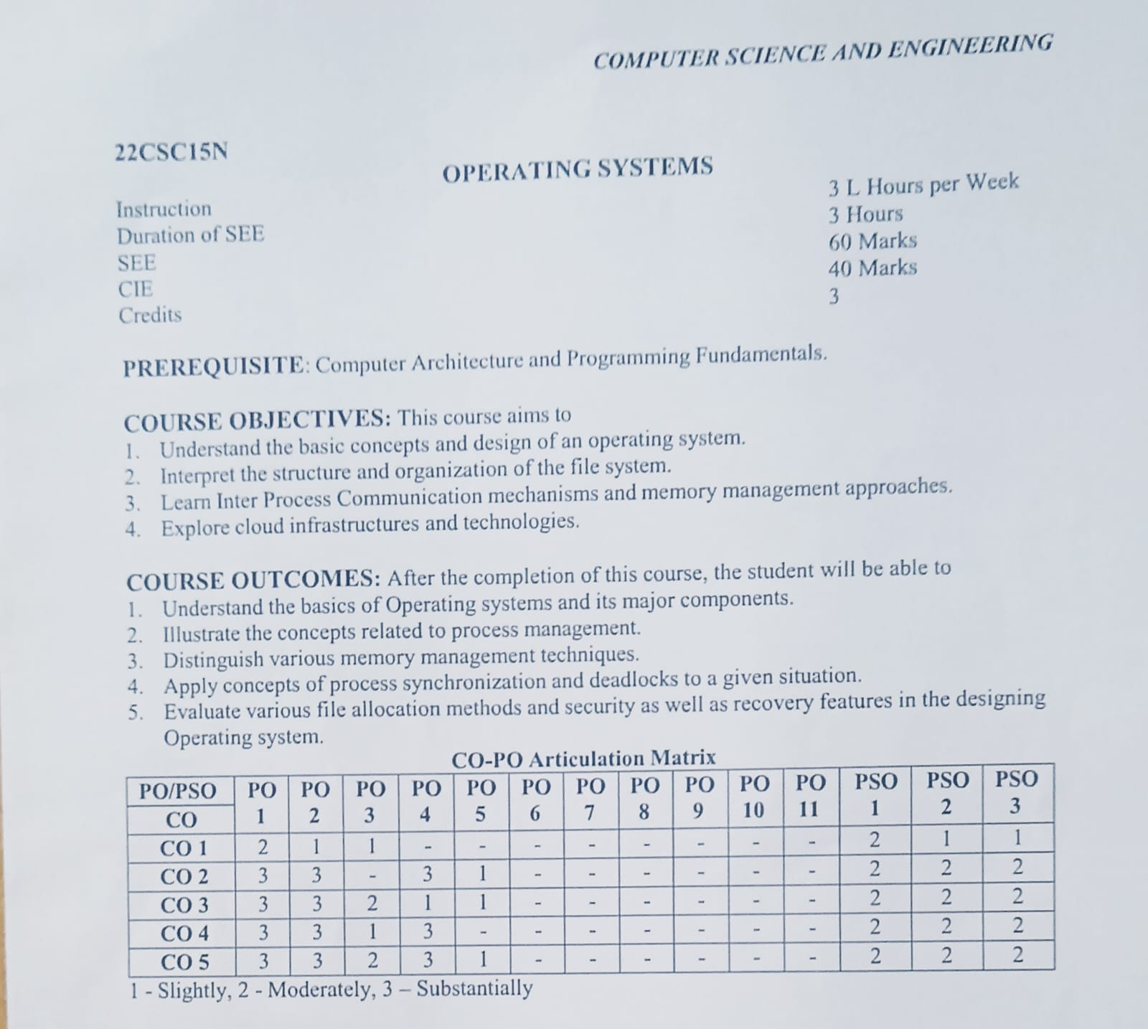
.

Slide 4
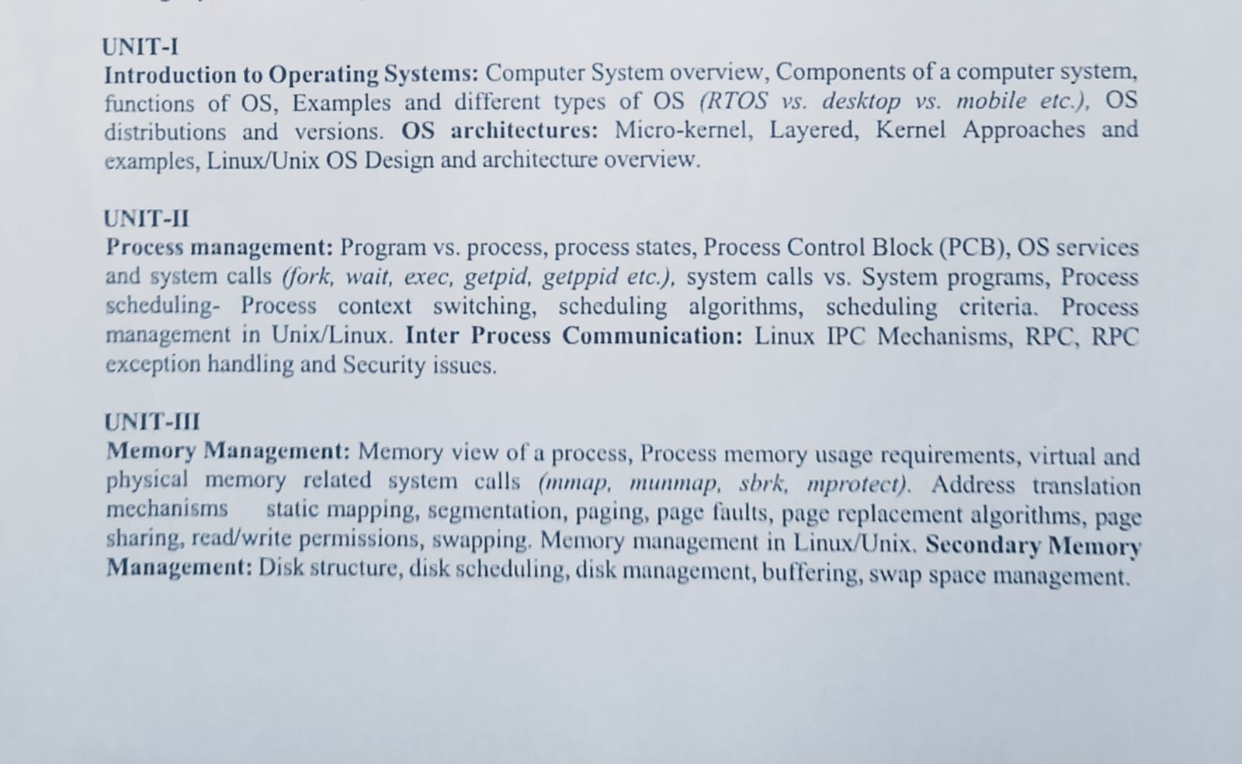
.

Slide 5
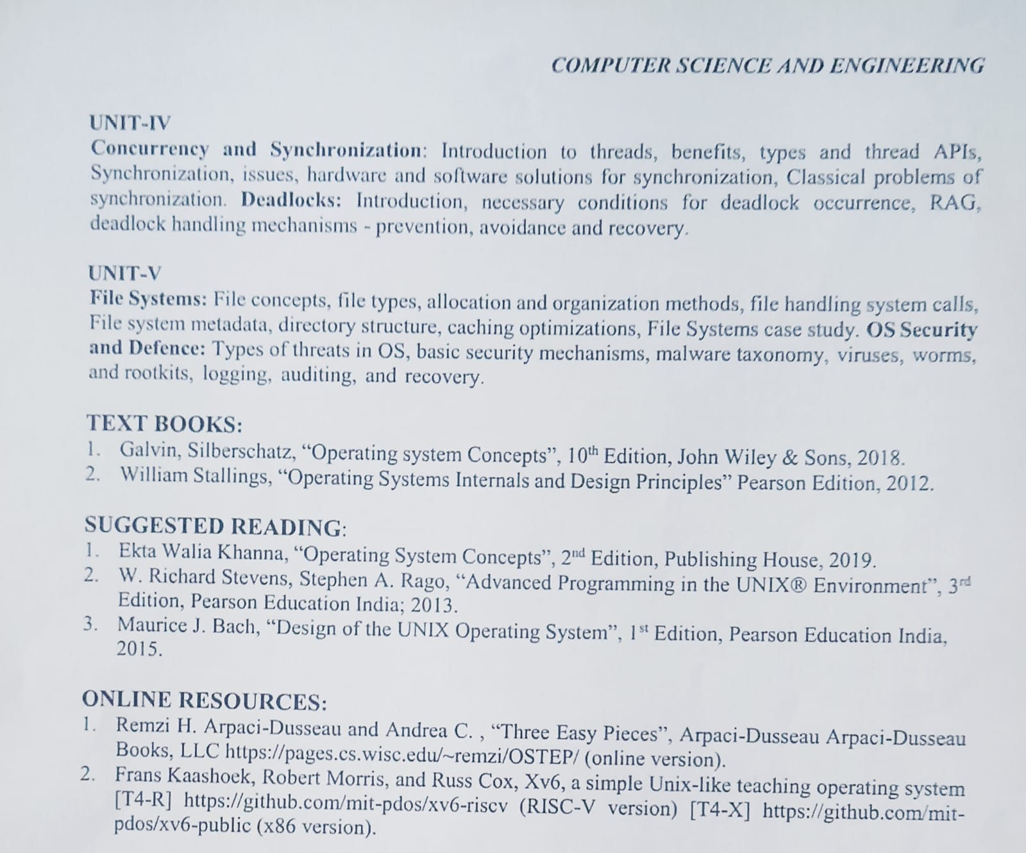
.

Slide 6
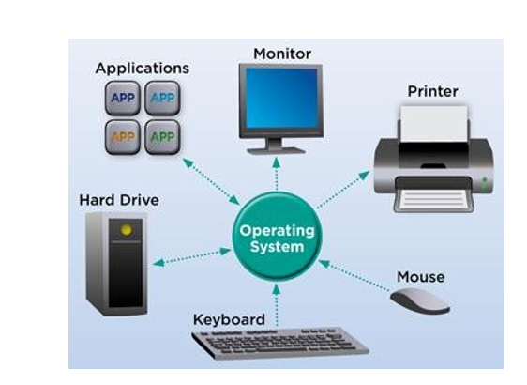
What is an Operating System?

Slide 7
Introduction to Operating Systems
An Operating System (OS) is an interface between computer user an computer hardware.
An operating system is a software which performs all the basic tasks like file management, memory management, process management, handling input and output, and controlling peripheral devices such as disk drives and printers.
Some popular Operating Systems include Linux Operating System, Windows Operating System, VMS, OS/400, AIX, z/OS, etc.
Definition
An operating system is a program that acts as an interface between the user and the computer hardware and controls the execution of all kinds of programs.
Operating system goals:
Execute user programs and make solving user problems easier
Make the computer system convenient to use
Use the computer hardware in efficient manner

Slide 8
Why Study Operating Systems?
Only a small percentage of Computer Science professional will be involved in the creation or modification of an operating system.
All code runs on top of an operating system.
Knowledge of
  How OS works,
  How OS drives computer hardware,
  What OS provides to applications
is crucial to write efficient, effective, and secure Code.

Slide 9
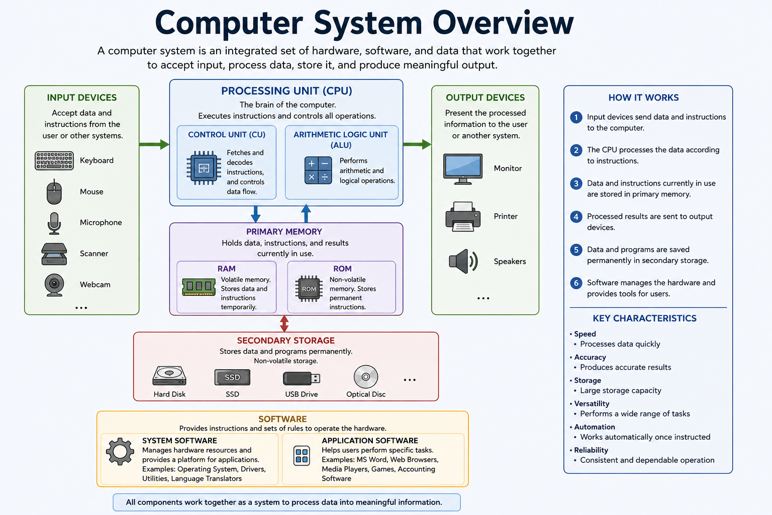
Computer System Overview

Slide 10
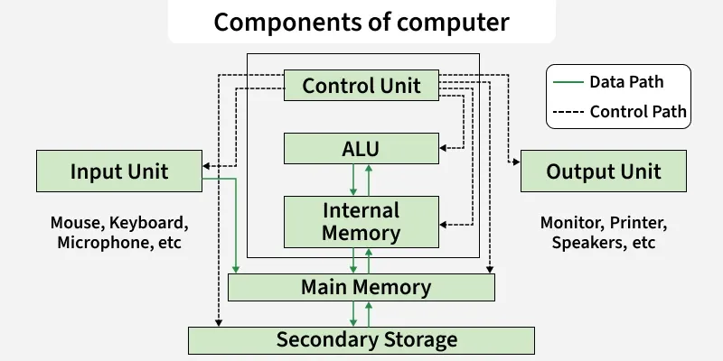
Components of Computer

Slide 11
Components of a computer system
A computer system consists of hardware, software, data, users, and procedures that work together to process information.
1. Hardware
Hardware refers to the physical parts of a computer that can be seen and touched.
Examples:
Keyboard , Mouse , Monitor ,CPU , Printer ,Hard Disk
Hardware Components:
Input Devices: Keyboard, Mouse, Scanner, Microphone
Processing Unit (CPU): Control Unit (CU) and Arithmetic Logic Unit (ALU)
Memory Unit: RAM and ROM
Storage Devices: HDD, SSD, USB Drive
Output Devices: Monitor, Printer, Speakers

Slide 12
Cont..
2. Software
Software is a set of programs and instructions that tell the computer what to do.
a) System Software
Controls and manages computer hardware.
Examples:
Operating Systems (Windows, Linux)
Device Drivers
Utility Programs
b) Application Software
Helps users perform specific tasks.
Examples:
MS Word
MS Excel
Web Browsers
Media Players

Slide 13
Cont..
3. Data
Data refers to raw facts and figures that are processed into meaningful information.
Examples:
Student marks
Employee records
Sales data
4. Users (Peopleware)
Users are the people who operate and interact with the computer system.
Examples:
Students , Teachers , Programmers , System Administrators
5. Procedures
Procedures are the rules and steps for operating a computer system.
Examples:
Steps to log in to a system
Backup procedures
Security guidelines

Slide 14
Functions of an Operating System (OS)
An Operating System (OS) is system software that acts as an interface between the user and computer hardware. It manages resources and provides services for application programs.
Major Functions of an Operating System
1.Process Management
Process management in operating system is about managing processes. A Process is a running program. The life cycle of process is from the moment program start until it finishes.
Creates, schedules, and terminates processes.
Allocates CPU time to different programs.
Supports multitasking.
Example: Running a web browser and a music player simultaneously.

Slide 15
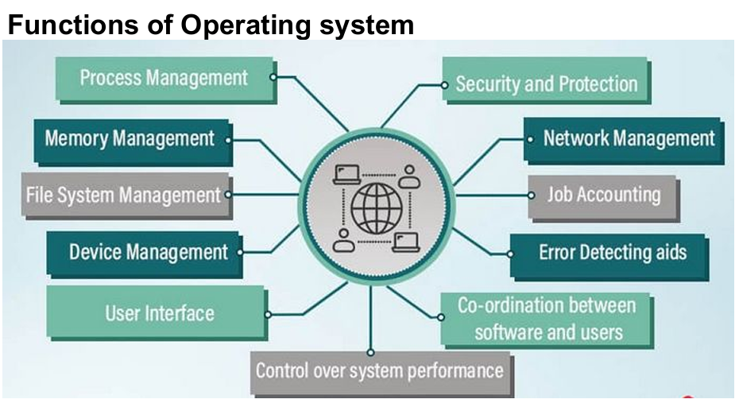
Functions of OS

Slide 16
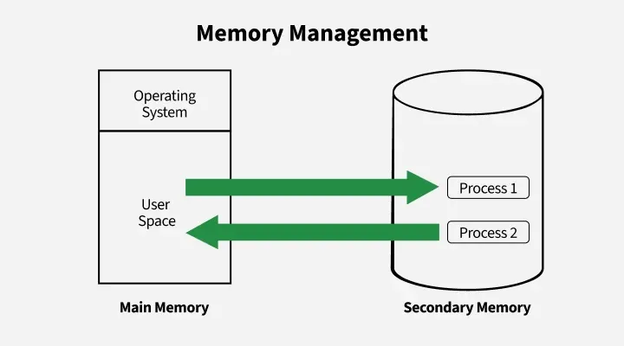
2. Memory Management
.Memory management in an operating system controls how data is stored and organized in main(primary) memory and secondary storage, ensuring programs get the memory they need and freeing it when no longer used.
Allocates and deallocates memory to programs.
Keeps track of memory usage.
Manages virtual memory.
Example: Assigning RAM to different applications.

Slide 17
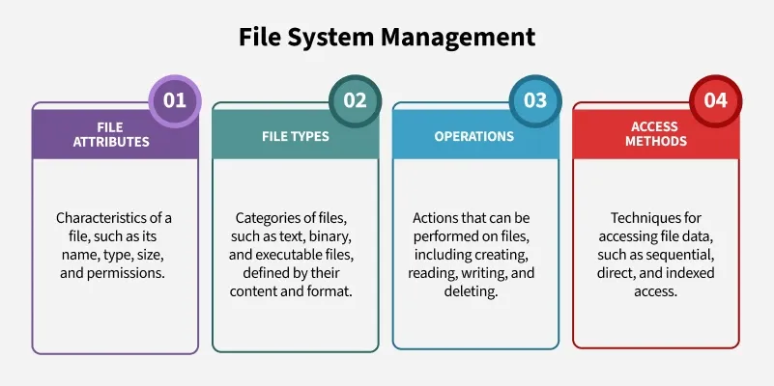
3. File System Management
.File management in an operating system organizes and controls how data is stored, named, and accessed on storage devices, making it easy for users to find and use their files.
Creates, deletes, copies, and organizes files and folders.
Maintains file directories.
Controls file access permissions.
Example: Saving documents in folders.

Slide 18
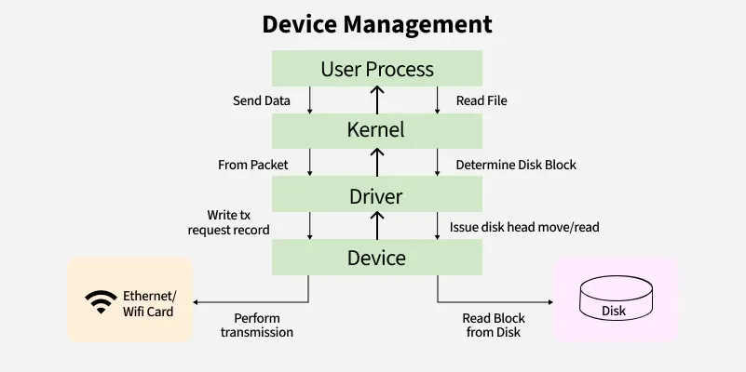
Cont..
4. Device Management
Device management in an operating system controls how the computer communicates with hardware devices like printers or disks, using drivers and techniques to ensure smooth and efficient operation.
Controls and coordinates hardware devices.
Uses device drivers for communication.
Allocates devices to processes.
Example: Managing printers, keyboards, and scanners.

Slide 19
Cont..
5. Input/Output Management
Handles communication between input/output devices and the CPU.
Manages data transfer efficiently.
Example: Reading data from a keyboard and displaying it on a monitor.
6. User Interface
Provides a way for users to interact with the computer.
Types:
CLI (Command Line Interface): MS-DOS(Microsoft Disk Operating system), Terminal
GUI (Graphical User Interface): Windows, macOS

Slide 20
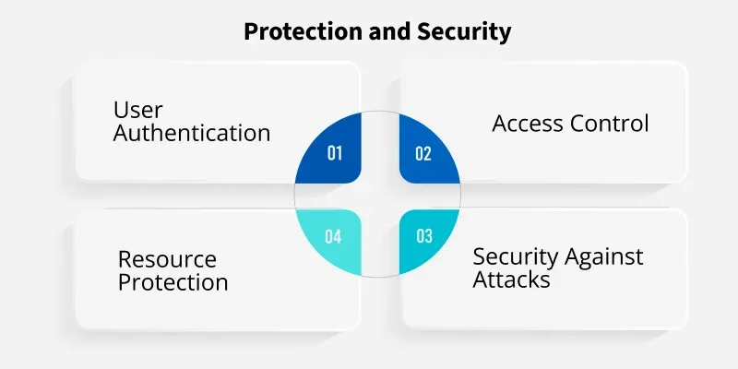
7. Protection and Security
Protection and Security mechanisms in an OS are designed to safeguard system resources from unauthorized access or misuse. These mechanisms control which processes or users can access specific resources (such as memory, files, and CPU time). It also ensures that only authorized users can perform specific actions.
Protects data and system resources.
Provides user authentication through usernames and passwords.
Prevents unauthorized access.
Example: Login security in Windows and Linux.
Access Control: Limits user and process permissions.
Authentication: Verifies users through credentials (UIDs/SIDs).
Resource Protection: Prevents misuse of files, memory, or devices.
Security: Guards against malware, denial-of-service attacks, and data theft.

Slide 21
Cont..
8. Resource Management
Manages CPU, memory, storage, and peripheral devices.
Ensures efficient utilization of resources.
9. Error Detection and Handling
Detects hardware and software errors.
Takes corrective actions and reports errors.
Example: Displaying error messages when a file cannot be opened.
10. Networking
Supports communication between computers.
Manages network resources and connections.
Example: Sharing files and printers over a network.

Slide 22
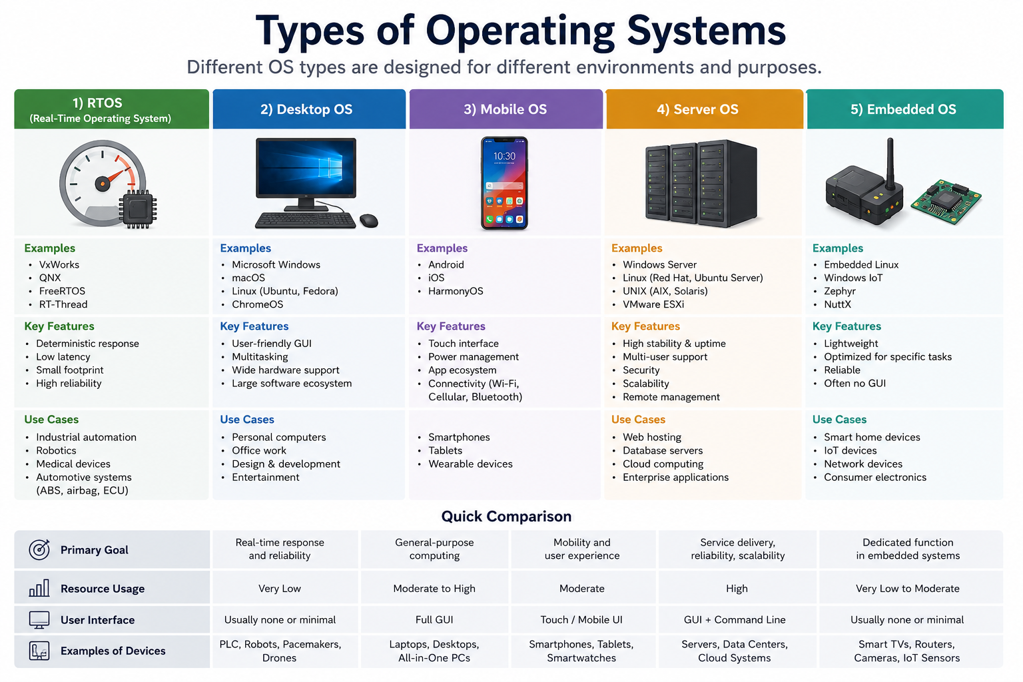
Examples and different types of OS (RTOS vs. desktop vs. mobile etc.)

Slide 23
What is an Operating System (OS)?
An Operating System (OS) is system software that acts as an interface between the user and computer hardware. It manages memory, CPU, files, input/output devices, and allows applications to run.
Examples:
Microsoft Windows
Linux
macOS
Android
iOS

Slide 24
Types of Operating System
Different types of operating systems are mentioned below:
1.Batch Operating System
2.Real-Time Operating System
3.Desktop Operating System
4.Moblie System
5.Server Operating System
6.Embedded Operating System
7.Multi-Programming System
8.Multi-Processing System
9.Multi-Tasking Operating System
10.Network Operating System

Slide 25
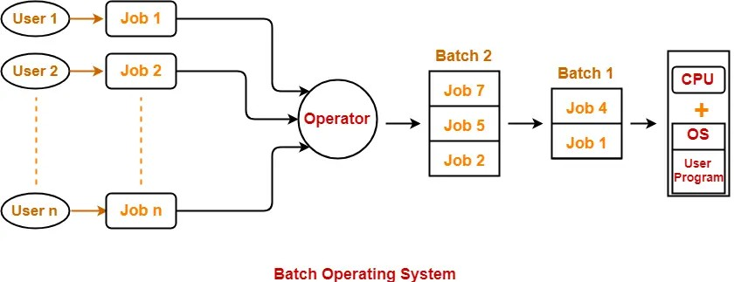
1. Batch Operating System
In a batch processing system, users submit their jobs to the system, and the operating system collects these jobs into batches.
The jobs in each batch are executed one after the other without any user intervention until all the jobs in the batch have completed.

Slide 26
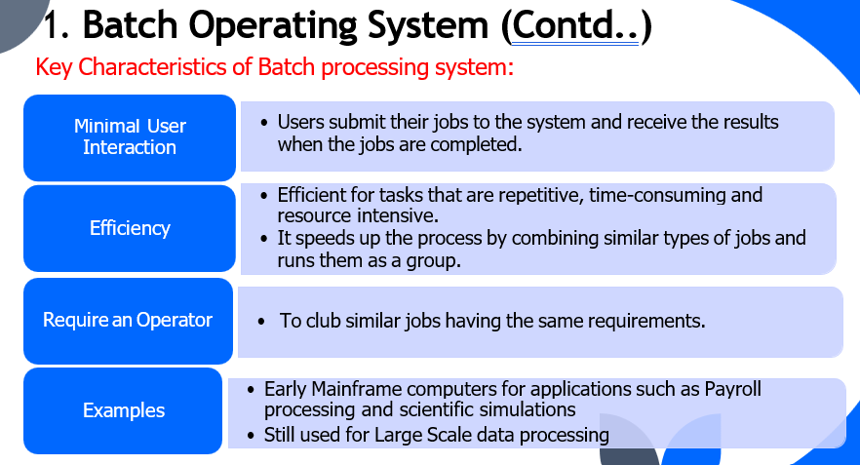
Cont..

Slide 27
2. Real-Time Operating System (RTOS)
A Real-Time Operating System is designed to respond to events within a guaranteed time. It is mainly used where timing is very critical.
Key Features
Fast response time
Very low latency
Highly reliable
Small memory footprint
Deterministic behavior (same response time every time)
Examples
VxWorks , QNX , FreeRTOS , RT-Thread
Applications
Industrial automation ,Robotics ,Medical equipment ,Aircraft systems ,Automotive systems (Airbags, ABS, Engine Control Units)
Advantages
Predictable execution ,High reliability , Fast response
Disadvantages
Limited graphical interface , Expensive development , Specialized for specific tasks

Slide 28
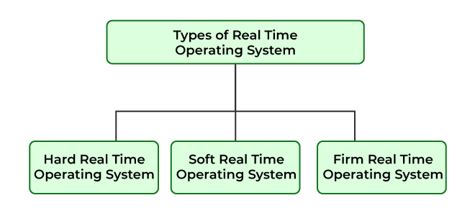
Types of Real-Time Operating System
The real-time operating systems can be of 3 types -

Slide 29
Cont..
1.Hard Real-Time Operating System : These operating systems guarantee that critical tasks are completed within a range of time. For example, a robot is hired to weld a car body.
2.Soft Real-Time Operating System : This operating system provides some relaxation in the time limit. For example - Multimedia systems
3.Firm Real-time Operating System : RTOS of this type have to follow deadlines as well. In spite of its small impact, missing a deadline can have unintended consequences, including a reduction in the quality of the product. Example: Multimedia applications.

Slide 30
3. Desktop Operating System
A Desktop OS is designed for personal computers and laptops. It provides a user-friendly graphical interface.
Key Features
Graphical User Interface (GUI)
Multitasking
Multi-user support
Supports many software applications
Easy to use
Examples
Microsoft Windows , macOS , Linux (Ubuntu, Fedora) , ChromeOS
Applications
Office work ,Programming , Gaming ,Internet browsing , Multimedia
Advantages
Easy to learn
Large software support
Supports various hardware
Disadvantages
Higher resource usage
More vulnerable to viruses (especially Windows)

Slide 31
4. Mobile Operating System
A Mobile OS is specially designed for smartphones, tablets, and wearable devices.
A Mobile Operating System is lightweight system software designed specifically to run applications on mobile devices such as smartphones and tablets. These operating systems are optimized for portability, battery efficiency, and touch-based interactions.
Mobile OS combines traditional computing features with mobility-specific capabilities like wireless connectivity, telephony services, GPS navigation, and sensor integration. They support external storage through memory cards and enable cellular network connectivity via SIM cards.
Popular mobile operating systems include Android (Linux-based), iOS (Unix-based), Windows Mobile, and BlackBerry OS.
Key Features
Touchscreen interface , Battery optimization
Wireless connectivity (Wi-Fi, Bluetooth, Cellular)
App Store support ,Built-in security
Examples: Android , iOS , HarmonyOS
Applications
Smartphones , Tablets , Smartwatches
Advantages
Portable , User-friendly , Energy efficient
Disadvantages
Limited compared to desktop OS ,Battery life constraints , Storage limitations

Slide 32
5. Server Operating System
A Server OS is designed to manage servers that provide services to multiple users over a network.
Key Features
High reliability
Security , Scalability
Multi-user support
Remote administration
Examples
Windows Server ,Red Hat Enterprise Linux ,Ubuntu Server , UNIX (AIX, Solaris) , VMware ESXi
Applications
Web hosting , Database servers , Cloud computing , Enterprise applications ,Email servers
Advantages
Handles many users simultaneously
High uptime
Strong security
Disadvantages
Expensive
Requires skilled administrators
Complex setup

Slide 33
6. Embedded Operating System
An Embedded OS is designed for dedicated devices that perform a specific function.
Key Features
Lightweight
Reliable
Low power consumption
Often no graphical interface
Optimized for specific hardware
Examples
Embedded Linux , Windows IoT , Zephyr , NuttX
Applications
Smart TVs , Routers , IoT devices , Smart home appliances , Security cameras
Advantages
Efficient
Small memory usage
Low power consumption
Disadvantages
Limited functionality
Difficult to upgrade
Device-specific

Slide 34
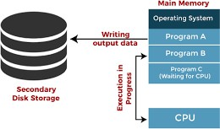
7.Multi-Programming Operating System
Before the concept of Multiprogramming, CPU executes only one program at a time.
When the program undergoes in waiting state for an input/output operation, the CPU remains idle which leads to underutilization of CPU and thus poor performance.
The concept of multiprogramming solves this issue by allowing more than
one program to execute in an operating system

Slide 35
Cont..
Features of Multiprogramming:
  Need Single CPU for implementation.
  Context switch between process.
  Switching happens when current process undergoes waiting state.
Advantages:
  CPU idle time is reduced.
  High resource utilization.
  High Performance.
Drawbacks:
  CPU scheduling algorithms is required.
  In case of large number of jobs, long-term jobs require a longer wait.
  Memory management is needed to meet the storage requirements of multiple programs

Slide 36
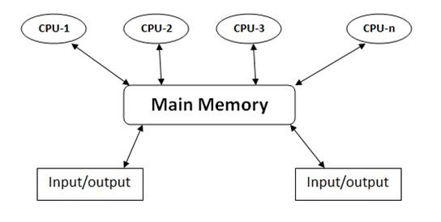
8. Multi-Processing Operating System
Multiprocessing systems are computer systems that utilize multiple processors or CPU cores to execute tasks concurrently.

Slide 37
Cont..
Advantages of Multi-Processing Operating System
It increases the throughput of the system.
As it has several processors, so, if one processor fails, we can proceed with another processor.
Disadvantages of Multi-Processing Operating System
Due to the multiple CPU, it can be more complex

Slide 38
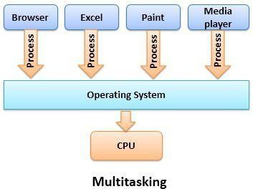
9.Multi-Tasking Operating System
Allows multiple tasks (processes) to run concurrently on a single computer system.
CPU switches rapidly between different tasks, giving the appearance that
multiple tasks are running simultaneously.

Slide 39
Cont..
Advantages:
  allowing users to work on multiple tasks simultaneously, reducing downtime and improving efficiency.
  Maximize resource utilization such as CPU time and memory
Drawbacks:
  Managing multiple tasks concurrently adds complexity to the operating system.
  Resource Contention can occur when multiple tasks compete for the same resources

Slide 40
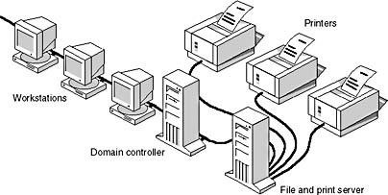
10.Networked Operating System
Networked operating systems primarily focus on managing network-related operations and services within a single computer or node.
They are designed to facilitate communication and connectivity within the local network.
Eg: Microsoft Windows Server 2003, Microsoft Windows Server 2008, Linux and Mac OS X.

Slide 41
Cont..
Advantages:
  Centralized servers are highly stable.
  Security is server managed.
  Upgradation of new technologies and hardware can be easily integrated into the system.
  It is possible to remotely access servers from different locations
Disadvantages:
  High cost of buying and running a server.
  Dependency on a central location for most operations.
  Regular maintenance and updates are required.

Slide 42
RTOS vs Desktop OS vs Mobile OS
Feature | RTOS | Desktop OS | Mobile OS
Purpose | Time-critical tasks | General-purpose computing | Portable computing
Response Time | Guaranteed | Not guaranteed | Fast but not guaranteed
Interface | Minimal | GUI | Touch Interface
Battery Optimization | No | No | Yes
Examples | FreeRTOS | Windows | Android

Slide 43
Operating System Distributions
An Operating System (OS) distribution is a customized version of an operating system that includes the core OS along with additional software, tools, drivers, and package managers for specific users or purposes.
A distribution (distro) is mainly used with Linux.
An operating system distribution is a complete package of an operating system that includes the core OS kernel, system utilities, libraries, and often a collection of software applications and tools.
These distributions are typically customized and bundled to serve various purposes and cater to different user needs

Slide 44
Operating System Distributions
1. Linux Distributions (Distros)
Linux is open-source, so many organizations create their own distributions based on the Linux kernel.
Linux distributions like Ubuntu, Debian, CentOS, Fedora, and Arch Linux are examples of operating system distributions.
Cater to desktop, server, and embedded use cases
Popular Linux Distributions
Ubuntu
is one of the most widely used Linux distributions, especially for beginners. It is user-friendly, has strong community support, and is widely supported by major software vendors and cloud platforms, making it suitable for both desktop and server environments.
Easy to use
Regular updates
Large software repository
Used for desktops, servers, and cloud computing

Slide 45
Cont..
Fedora
is known for always having the latest software and technologies. It’s backed by Red Hat, a major player in the enterprise Linux world, and is often used by developers who want to work with cutting-edge technologies.
Latest software packages
Good for software developers
Strong security features
Debian
is known for its stability and is often used as the base for other distros, like Ubuntu. It’s a great choice for those who want a solid, secure system and don’t need the latest bleeding-edge features.
Highly stable
Reliable for servers
Large package collection

Slide 46
Cont..
Kali Linux
is specifically designed for cybersecurity tasks such as penetration testing, digital forensics, and ethical hacking. It comes preloaded with more than 600 security tools and is widely used by cybersecurity learners and professionals.
Designed for ethical hacking
Includes hundreds of security tools
Used by cybersecurity professionals
Linux Mint
is an easy-to-use distribution that looks and feels similar to Windows. It’s a good choice for users who are new to Linux and want something familiar.
User-friendly interface
Ideal for beginners
Similar experience to Windows

Slide 47
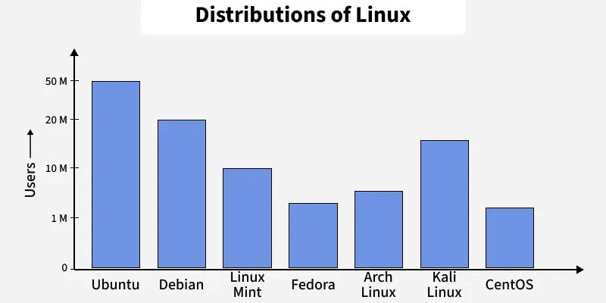
Top Linux Distributions
.

Slide 48
Operating System Distributions
2.UNIX Variants:
UNIX-like operating systems such as macOS, AIX (Advanced Interactive Executive), HP-UX (Hewlettte Packard Unix), and Solaris have their own distributions or versions customized for specific hardware and enterprise environments.
3.Windows Editions:
Microsoft Windows has multiple editions like Windows 10 Home, Windows 10 Pro, Windows Server, and Windows Enterprise, each tailored for different user categories and needs.

Slide 49
Operating System Versions
Operating systems are updated and improved over time to fix bugs, enhance security, and add new features.
Each new version typically receives a unique version number or name.
Operating system versions are crucial because they indicate the level of updates, security patches, and new features available in a particular release.
Users and administrators can choose the version that best suits their needs based on factors like stability, support, and compatibility with their hardware and software requirements.

Slide 50
Cont..
Windows Versions(version 25H2)
Microsoft releases different versions of Windows over time.
macOS Versions(version 26 (Tahoe))
Apple develops macOS for Mac computers.
Features
Secure
Smooth performance
Optimized for Apple hardware
Excellent multimedia support

Slide 51
Android
Android Versions(version 17) : Android versions are released by Google.
Developed by Open Handset Alliance (mostly Google)
  Open Source
Similar stack to IOS
Based on Linux kernel but modified
  Provides process, memory, device-driver management
  Adds power management
Runtime environment includes core set of libraries and Dalvik virtual machine
  Apps developed in Java plus Android API
    Java class files compiled to Java bytecode then translated to executable than runs in Dalvik VM
Libraries include frameworks for web browser (webkit), database (SQLite), multimedia, smaller libc
Features
Touch interface
Google Play Store
Battery optimization
High customization

Slide 52







Cont..
iOS Versions(version 26.5.2)
Apple develops iOS for iPhones.
Apple mobile OS for iPhone, iPad
  Structured on Mac OS X, added functionality
  Does not run OS X applications natively
    Also runs on different CPU architecture (ARM vs. Intel)
  Cocoa Touch Objective-C API for developing apps
  Media services layer for graphics, audio, video
  Core services provides cloud computing, databases
  Core operating system, based on Mac OS X kernel

Slide 53
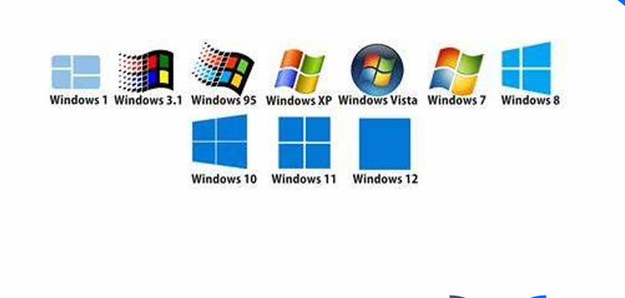
Operating System Versions

Slide 54
Operating Systems Structures / Architecture
An Operating System Architecture is the internal structure or design of an operating system. It defines how different components of the OS interact with each other and with the computer hardware.
OS structure depends on component organization and interaction.
Acts as a blueprint that guides OS design.
Breaking the OS into smaller parts simplifies development.
Structure defines how components are integrated into the kernel.
Types of Operating Systems Structures:
1.Micro-Kernel Structure
2.Layered Structure
3.Simple Structure
4.Modular Structure

Slide 55
Operating System (OS) Architectures
1. Microkernel Architecture
A Microkernel is an OS architecture where only the essential functions of the operating system run in the kernel (kernel mode). Other services run in user space.
Non-essential services run in user space, leaving a small core kernel.
New services can be added without changing the kernel.
More secure and reliable because failures don’t crash the whole OS.
This modular approach means that if one service fails, it doesn't crash the entire system since other services and the kernel continue running independently.
macOS uses microkernel ideas within its hybrid XNU kernel.
XNU is a hybrid kernel, meaning it merges features of both monolithic kernels and microkernels.
This design balances the modularity of a microkernel
with the high performance of a monolithic structure.
The kernel performs only the most basic tasks:
Process management , Memory management
Inter-Process Communication (IPC) ,CPU scheduling , System Calls
Services such as: File system , Device drivers , Networking

Slide 56
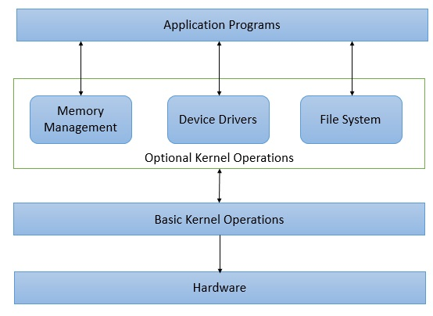
Cont..
The user opens an application (for example, MS Word).
The application requests services from the kernel. If the request involves:
The optional modules communicate with the Basic Kernel Operations.
The Basic Kernel Operations interact with the Hardware.
The result is sent back to the application.

Slide 57
Cont..
Features
Small kernel size
High security
Better reliability
Easy to maintain
Fault isolation
Modular design
Examples
QNX ,MINIX 3 ,L4 ,Zircon (used in Fuchsia)
Applications
Medical devices
Automotive systems
Embedded systems
Aerospace
Industrial automation

Slide 58
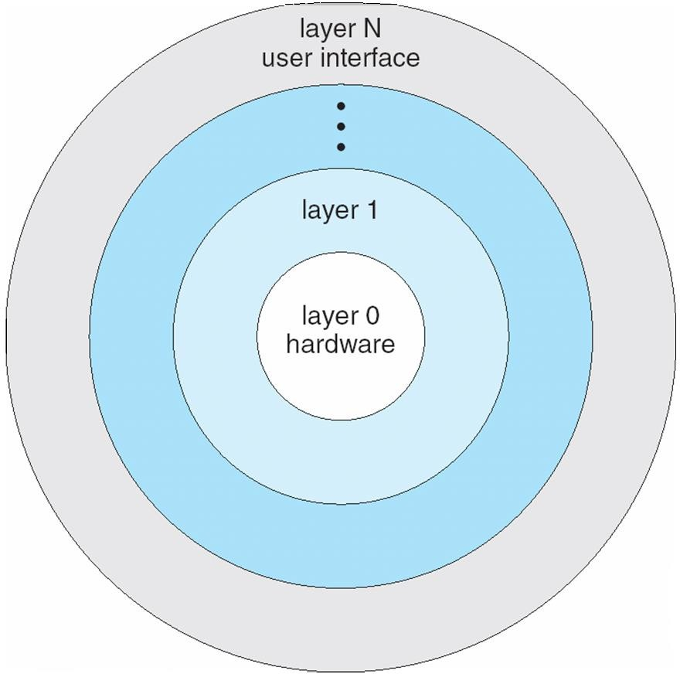
2. Layered Architecture
In Layered Architecture, the operating system is divided into multiple layers. Each layer performs a specific function and communicates only with the layer directly above or below it.
Each higher layer uses the services provided by the lower layer.

Slide 59
Cont..
In Layered structure the OS is divided into levels where each layer uses the services of the one below it hardware at the bottom and the user interface at the top. This design improves organization and simplifies debugging, as errors can be isolated to specific layers. However, it adds overhead because data must pass through multiple layers and requires careful planning. Unix is an example of this structure.
OS is divided into multiple layers (hardware at bottom, UI at top).
Each layer uses the functions of the layer below it.
Easier debugging because errors are isolated to specific layers.
Adds overhead due to data passing through many layers.
Requires careful planning; layers can only use lower layers.
UNIX is an example of a layered structure.

Slide 60
Cont..
Features
Organized into layers
Modular design
Easy to understand
Easy debugging
Better maintainability
Examples
THE Operating System (the first layered OS)
Some parts of modern operating systems like Windows and Linux use layered design concepts.

Slide 61
3.Simple Structure
Simple-structure operating systems have no well-defined architecture and are small, simple and limited in functionality. Their interfaces and functional levels are not clearly separated, which makes them less reliable. Because of this lack of separation, a failure in any user program can cause the entire system to crash.
No well-defined structure; small and limited.
Interfaces and functionality levels are not separated.
MS-DOS(Microsoft Disk Operating System) is an example of this structure.
Applications can directly access basic I/O routines.
A user program failure can crash the entire system.
This is the software used by the user.(Text Editor, Calculator, Games)
Performs user tasks.
Requests services from the operating system.
These are programs that remain in main memory (RAM) after the operating system starts.
Command Interpreter , File management, Input/Output services
Device drivers allow MS-DOS to communicate with hardware devices.
Keyboard driver, Mouse driver, Printer driver, Disk driver

Slide 62
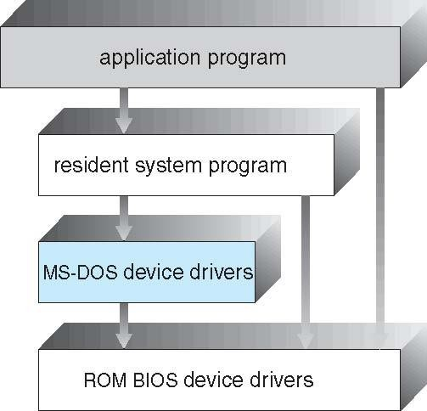
Cont..
The user opens an Application Program.
The application sends a request to the Resident System Programs
The resident system programs use MS-DOS Device Drivers to access hardware.
The device drivers communicate with the ROM BIOS.
The BIOS accesses the hardware and returns the result.

Slide 63
4.Modular Structure
A modular structure uses a kernel that contains only essential core components, while additional services are added as loadable modules during boot or runtime. It is similar to a layered design because it has defined and protected interfaces, but it is more flexible since modules can communicate freely. This approach is widely used in modern systems such as Solaris.
Kernel contains only core components.
Extra services are added as dynamically loadable modules.
More flexible than layered structure; modules can call any other module.
Used in systems like Solaris.
1. Core Solaris Kernel
The Core Kernel is the heart of the operating system.
Process Memory management, CPU scheduling, Communication with hardware
2. Device and Bus Drivers
These modules help the operating system communicate with hardware devices.
Keyboard , Mouse, USB, Graphics driver,

Slide 64
Cont..
3. Scheduling Classes
These modules determine how CPU time is allocated to processes.
Select the next process to execute ,Assign CPU time improve system performance
4. Executable Formats
These modules allow the operating system to run different executable file formats.
ELF (Executable and Linkable Format) , a.out
5. File Systems
The file system module manages files and directories.
Create files ,Delete files ,Read files ,Write files
6. Loadable System Calls
These modules allow the operating system to add new system calls without rebuilding the kernel.
Extend kernel functionality , Add new services dynamically
7. Streams Modules
Streams modules are mainly used for input/output (I/O) and communication.
Handle network communication ,Process data streams
8. Miscellaneous Modules
These are additional modules that provide optional features.
Security modules ,Encryption modules ,Debugging modules

Slide 65
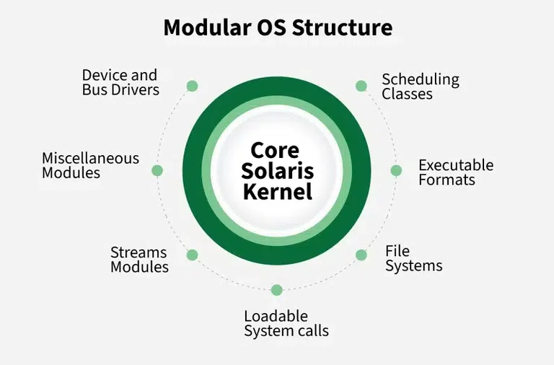
Cont..
The user opens an application.
The application requests an operating system service.
The Core Kernel determines which module is needed.
If the required module is not loaded, the OS loads it dynamically.
The selected module performs the requested task.
The result is returned to the application.

Slide 66
Kernel Approaches and Examples
What is a Kernel?
The Kernel is the core part of an Operating System (OS). It acts as a bridge between applications and the computer hardware.
Functions of the Kernel
Process management
Memory management
File system management
Device management
CPU scheduling
Input/Output (I/O) management
Security and access control
Kernel Approaches
There are mainly four kernel approaches:
1.Monolithic Kernel
2.Microkernel
3.Hybrid Kernel
4.Exokernel

Slide 67
1.Monolithic Architecture
A Monolithic Kernel contains all major operating system services within a single large kernel running in kernel mode.
In monolithic architecture, each component of the operating system is contained in the kernel i.e. it is working in kernel space
The components of the operating system communicate with each other using function calls.
Examples:
OS/360 (IBM-1960’s) VMX (Virtual Machine eXtensions by Intel) , and LINUX

Slide 68
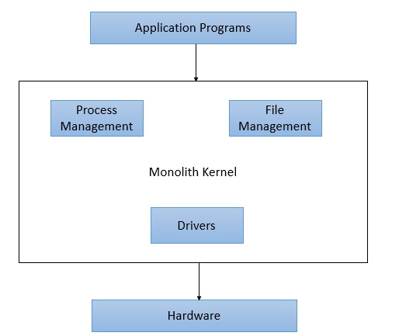
Cont.

Slide 69
Cont..
These services include:
Process management
Memory management
File system
Device drivers
Networking
All components communicate directly, making the system fast.
Examples: Linux ,UNIX ,FreeBSD
Advantages
High performance
Fast communication between components
Efficient resource management
Disadvantages
Large kernel size
Difficult to maintain
A bug in one component can crash the entire system

Slide 70
2. Microkernel
A Microkernel keeps only the essential services inside the kernel. Other services run in user space.
Kernel includes:
Process management
Memory management
Inter-Process Communication (IPC)
CPU scheduling
User-space services include:
File system
Device drivers
Networking
Examples :
QNX , MINIX 3 , L4 , Zircon (used in Fuchsia)
Advantages
High security
Better reliability
Easy maintenance , Fault isolation
Disadvantages
Slower than monolithic kernels due to IPC overhead

Slide 71
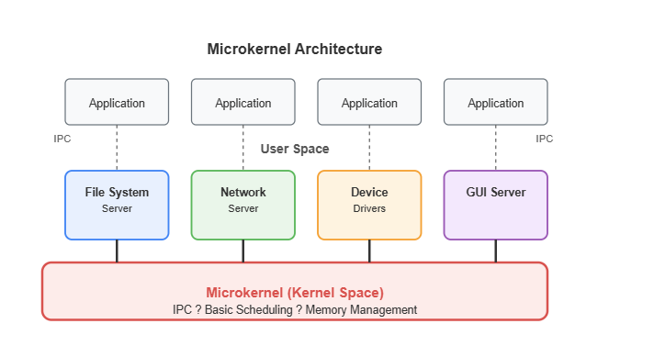
Cont..

Slide 72
3. Hybrid Kernel
A Hybrid Kernel combines the features of Monolithic and Microkernel architectures.
Performance similar to a monolithic kernel
Security and modularity similar to a microkernel
Some services run in kernel mode, while others can run in user mode.
Examples
Microsoft Windows (Windows NT family)
Apple macOS (XNU kernel)
Advantages
Better performance
Improved security
Flexible and modular
Disadvantages
More complex design
Larger than a microkernel

Slide 73
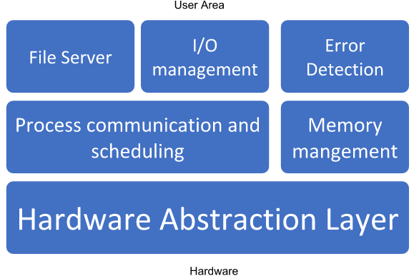
Architecture:

Slide 74
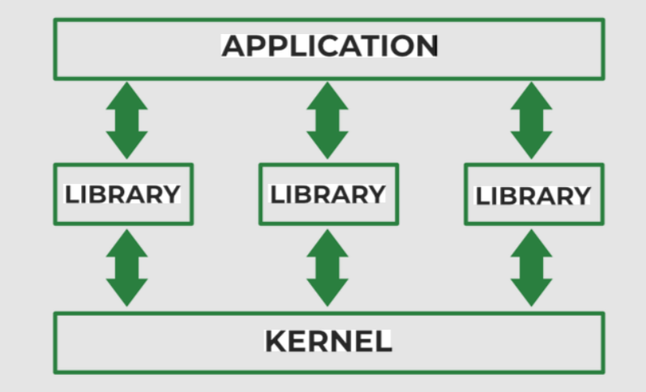
4. Exokernel
An Exokernel provides only the basic mechanisms for securely sharing hardware resources. Most operating system services are implemented in user-level libraries, allowing applications to manage resources more directly.
Examples
MIT Exokernel (research project)
Nemesis (research operating system)
Advantages
Very high performance
Flexible
Efficient resource utilization
Disadvantages
Difficult to develop
Less commonly used

Slide 75
Architecture of Linux
What is Linux ?
Linux is an open-source operating system kernel created by Linus Torvalds in 1991. Linux follows many UNIX design principles and is often called a UNIX-like operating system.
The Linux operating system architecture defines how different components of the system interact with each other to manage hardware resources, run applications, and provide a stable and secure computing environment. Linux follows a layered architecture, where each layer has a specific role and responsibility.
The main components of Linux operating system are:
Application
Shell
Kernel
Hardware
Utilities

Slide 76
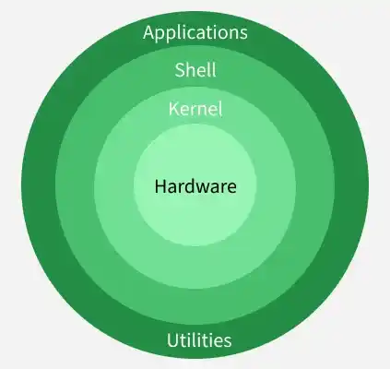
Linux Architecture
Linux follows a layered architecture where each layer performs a specific function.

Slide 77
The main components of Linux operating system are:
1. User Applications
Applications are programs that users interact with.
The software that a user is running on an operating system it can be either system or application software
Examples
Web Browser ,Text Editor ,Compiler ,Media Player ,Database Software
Applications request services from the kernel through system calls.
2. Shell
The Shell is the command interpreter that acts as an interface between the user and the kernel.
The shell accepts user commands, interprets them, and requests the kernel to perform the required operations.
The shell represents software that provides an interface for the user where it serves to launch or start some program for which the user gives instructions.

Slide 78
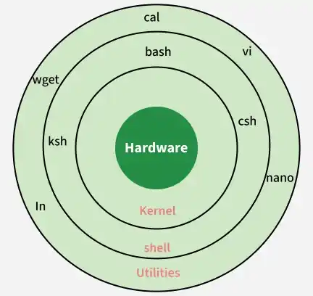
Cont..
.

Slide 79
Cont..
Popular Shells / Different types of shell
1.Bourne Shell (sh)
2. C Shell (csh)
3. Korn Shell (ksh)
4. Bash (Bourne Again Shell)
5. Z Shell (zsh)
6. Fish (Friendly Interactive Shell)
1. Bourne Shell (sh) : simple command line editing features. Supports variables and scripting
One of the earliest Unix shells, providing basic command execution and simple scripting capabilities
Reliable and lightweight, still widely used for system scripts and compatibility purposes
2. C Shell (csh)
Designed with a syntax similar to the C programming language, making it familiar to C developers
Introduced features like command history, but is less suitable for complex scripting
Ability to recall and reuse previous commands

Slide 80
Example
</> Is (Bash) : Displays the list of files.
</> pwd : Displays the current working directory.
</> mkdir Project : Creates a directory named Project.
3. Kernel
The Kernel is the core of the operating system. It acts as an interface between applications and hardware.
Kernel many does low level program 0’s/1’s
The kernel is responsible for:
Process Management : Schedules processes and controls execution using queues
Creates processes
Terminates processes ,CPU Scheduling
Memory Management :Allocates and manages system memory efficiently
Allocates memory
Deallocates memory
Virtual Memory

Slide 81
Cont..
File System Management
Creates files
Deletes files
Controls file permissions
Device Management : Controls hardware devices through device drivers
Communicates with hardware devices
Controls device drivers
Network Management: Responsible for handling all network communication, including data transmission, routing, and network protocols
Handles communication over networks
Manages TCP/IP protocols
Security : Enforces access control and system-level security mechanisms
User authentication
Access permissions

Slide 82
Cont...
4. Hardware Layer
The hardware is the physical part of the computer.
Examples
CPU ,RAM ,Hard Disk ,Keyboard ,Mouse ,Printer ,Network Card
Functions
Executes instructions , Stores data
Performs input/output operations
5.System utilities
System utilities are command-line tools that help users and administrators manage, configure, and monitor the Linux system. They simplify system administration by providing ready-to-use commands for common tasks.
Perform file and directory management operations
Monitor system performance and resource usage
Manage users, groups, and permissions
Configure and troubleshoot network settings

Slide 83
Introduction to UNIX System
What is UNIX?
UNIX is a powerful, multiuser, multitasking operating system developed in the 1970s at Bell Labs by Ken Thompson, Dennis Ritchie, and their colleagues.
UNIX is a multitasking and multiuser operating system designed to provide a stable, secure, and efficient computing environment. It was originally developed at AT&T Bell Labs and later became the foundation for many modern operating systems.
It supports the execution of multiple tasks or processes simultaneously.
It is widely known for its reliability, structured design, and long-term stability.
Its design principles have influenced many modern systems such as linux BSD, and macOS.
Features of Linux/UNIX
Multiuser ,Multitasking Operating System
Portable ,Secure ,Stable and Reliable ,Open Source (Linux) ,Supports Networking
Command-Line Interface (CLI) and Graphical User Interface (GUI)

Slide 84
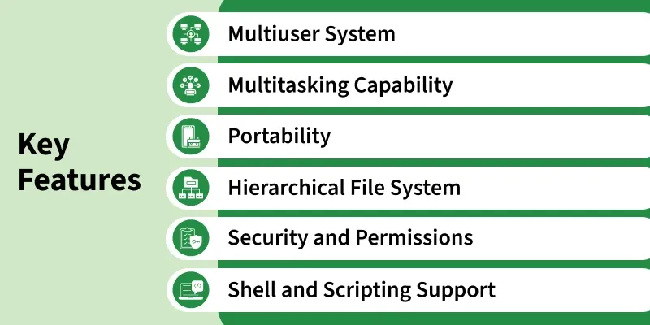
Key Features
The key features of the UNIX operating system are listed below:

Slide 85
Cont..
1. Everything is a File
In Linux/UNIX, almost every resource is treated as a file.
Examples: Regular files ,Directories ,Devices , Pipes , Sockets
2. Multiuser
Many users can use the same system simultaneously.
Multiple users can access the system at the same time without affecting one another’s processes.
Each user gets separate permissions and environments to ensure privacy and secure operations.
Example: University servers ,Office servers
3. Multitasking
Multiple programs can run at the same time.
UNIX can execute several processes simultaneously through efficient CPU scheduling.
Background and foreground tasks can run together, improving productivity and resource usage.
Example:
Listening to music ,Editing a document ,Downloading files

Slide 86
Cont…
4. Portability
Linux can run on many hardware platforms.
Written mostly in the C language, allowing easy movement of UNIX to different hardware platforms.
Only minimal changes are required to adapt UNIX to new systems, making it widely supported.
Examples: PC ,Laptop ,Raspberry Pi , Supercomputer
5. Security
UNIX assigns permissions (read, write, execute) to user, group, and others for file protection.
Authentication through usernames and passwords ensures secure access control.
Linux provides:
User accounts
File permissions ,Password protection ,Firewall support

Slide 87
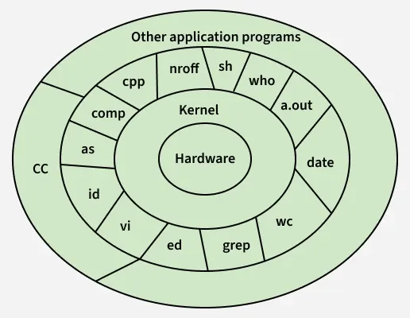
Layered Structure of UNIX Operating System
The layered structure of the UNIX operating system organizes its components into hierarchical levels-hardware, kernel, system utilities, and applications to ensure efficient, secure, and modular system functioning.

Slide 88
Cont..
Layer-1: Hardware
Represents the physical components of the computer, such as the CPU, memory, storage devices, and input/output hardware.
All system operations depend on this layer, as it forms the base of the entire UNIX architecture.
Layer-2: Kernel
The kernel is the core of the UNIX operating system and directly interacts with the hardware.
It manages essential tasks such as memory allocation, process scheduling, file handling, device control, and overall resource management.
Layer-3: System Programs, Commands, and Utilities
This layer includes compilers (cc, as, ld), editors (vi, ed), text processors (nroff), and the shell (sh).
It also contains common UNIX tools and commands like wc, grep, date, who, and a.out, which rely on the kernel to perform different functions such as text processing, file management, and system monitoring.
Layer-4: Application Layer
Represents user-developed or external application programs that run on top of system utilities and shell environment.
These applications use underlying layers (system utilities and kernel) to execute tasks successfully and provide services to the user.

Slide 89
.
Thank you…

Slide 92
Linux Boot Process (Overview)
When the computer starts, Linux boots in the following order:
Power ON
│
▼
BIOS / UEFI(Basic input/output system)(unified Extensible firmware interface)
│
▼
Boot Loader (e.g., GRUB)
│
▼
Linux Kernel
│
▼
Init/System Manager (systemd)
│
▼
System Services
│
▼
Login Screen / Shell

Slide 93
Cont..
Steps
Power On – The computer starts.
BIOS/UEFI – Checks the hardware (POST).
Boot Loader – Loads the Linux kernel into memory.
Kernel – Initializes hardware and system resources.
Init/System Manager – Starts essential services.
Login – User logs in and begins using the system.
Advantages of Linux/UNIX Design
Fast performance
High security
Excellent stability
Supports multiple users
Efficient resource management
Open-source (Linux)
Highly customizable

Slide 94
Cont..
Disadvantages
Steeper learning curve for beginners
Some commercial software is unavailable
Hardware compatibility may vary
Many administrative tasks use the command line

